Slide 1
Hive

Slide 2
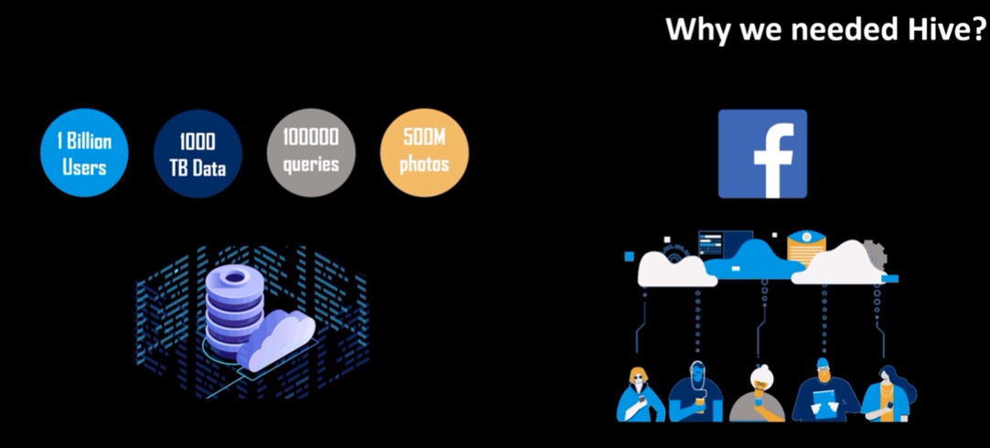
Why we need Apache Hive?

Slide 3
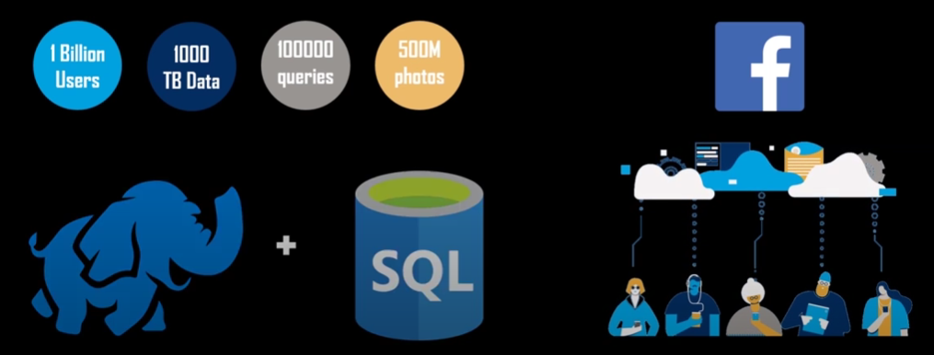

Slide 4


Slide 5


Slide 6
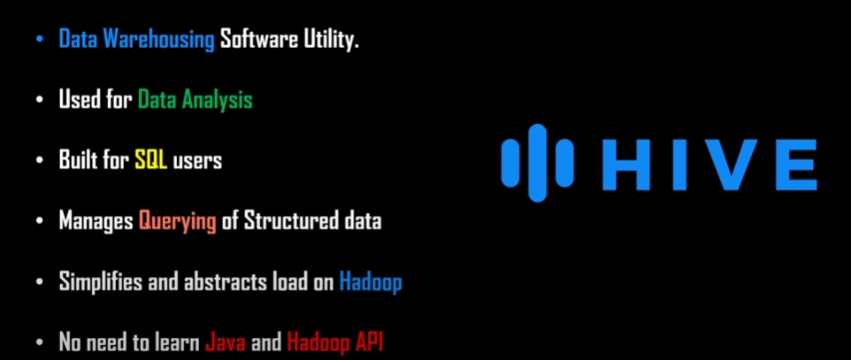
What is Apache Hive

Slide 7
Apache Hive Applications
Data Mining
Document Indexing
Predictive Modeling
Business Intelligence
Log Processing

Slide 8
Features Of Hive
It stores schema in a database and processed data into HDFS.
It is designed for OLAP.
It provides SQL type language for querying called HiveQL or HQL.
It is familiar, fast, scalable, and extensible.

Slide 9
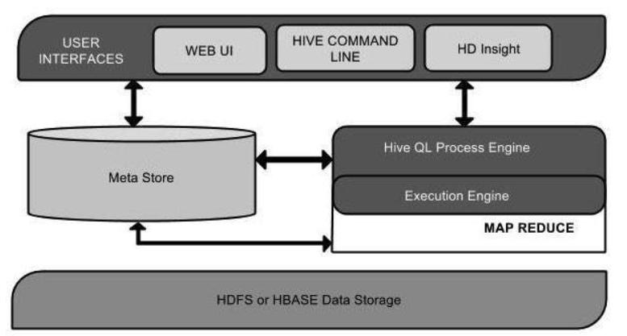
Artitecture Of Hive

Slide 10
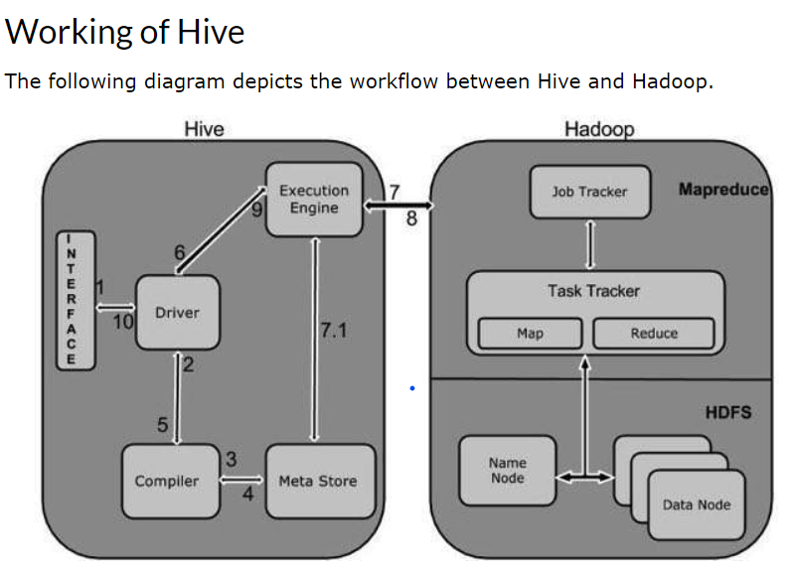

Slide 11
Sqoop: It is used to import and export data to and from between HDFS and RDBMS.
Pig: It is a procedural language platform used to develop a script for MapReduce operations.
Hive: It is a platform used to develop SQL type scripts to do MapReduce operations.

Slide 12
Ways to Execute MapReduce Operations
The traditional approach using Java MapReduce program for structured, semi-structured, and unstructured data.
The scripting approach for MapReduce to process structured and semi structured data using Pig.
The Hive Query Language (HiveQL or HQL) for MapReduce to process structured data using Hive.

